Slide 1




University Institute of Engineering
Department of Computer Science & Engineering
COMPUTER ORGANIZATION & ARCHITECTURE
(23CST-204/23ITT-204)
ER. SHIKHA ATWAL
E11186
ASSISTANT PROFESSOR
BE-CSE

Slide 2
UNIFORM MEMORY ACCESS (UMA)
UMA is a shared memory architecture used in parallel computers.
All the processors in the UMA model share the physical memory uniformly.
Access time to a memory location is independent of which processor makes the request or which memory chip contains the transferred data.
There are three types of uniform memory access (UMA) architectures, they include: UMA using multistage interconnection networks, bus-based symmetric multiprocessing (SMP) architectures and using crossbar switches.

Slide 3
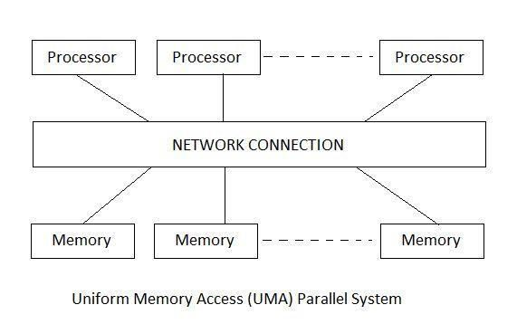
About Uniform Memory Access (UMA)
Memory access time is balanced or equal.
There are three types of buses used in UMA including Single, Multiple and Crossbar.
Used in time-sharing applications and general-purpose applications.
Less bandwidth when compared to Non-uniform Memory Access.
It has a single memory controller.
It is slower than Non-uniform Memory Access.

Slide 4
NON-UNIFORM MEMORY ACCESS (NUMA)
NUMA is a computer memory design used in multiprocessing where the memory access time depends on the memory location relative to the processor.
It was developed largely due to the advent of modern microprocessors that are faster than memory speeds. As a result, local memory is placed closer to the processor, reducing signal path length together with latency times with fewer delays in accessing memory.
It allows for faster and easy access to memory for the processors, as opposed to shared memory architectures where access times may be longer, thus slowing down execution of key processor and systems tasks.

Slide 5
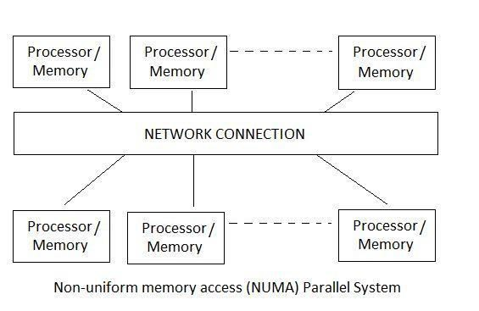
About Non-Uniform Memory Access (NUMA)
In this, memory access time is not balanced or equal.
There are two types of buses used in NUMA including Tree and Hierarchical.
Used in real-time applications and time-critical applications.
More bandwidth when compared to Uniform Memory Access.
Multiple memory controllers and faster than uniform memory access.

Slide 6
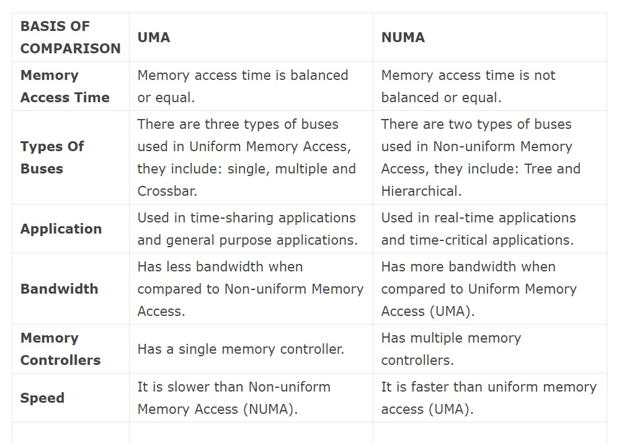
Difference Between UMA And NUMA

Slide 7
References
Reference Books:
J.P. Hayes, “Computer Architecture and Organization”, Third Edition.
Mano, M., “Computer System Architecture”, Third Edition, Prentice Hall.
Stallings, W., “Computer Organization and Architecture”, Eighth Edition, Pearson Education.
Text Books:
Carpinelli J.D,” Computer systems organization &Architecture”, Fourth Edition, Addison Wesley.
Patterson and Hennessy, “Computer Architecture”, Fifth Edition Morgaon Kauffman.

Slide 8
Other References:
https://www.tutorialspoint.com/difference-between-uma-and-numa
https://en.wikipedia.org/wiki/Uniform_memory_access
https://www.techopedia.com/definition/4617/non-uniform-memory-access-numa
https://vivadifferences.com/6-differences-between-uniform-memory-access-and-non- uniform-memory-access/
Video Links:
https://youtu.be/F2EtY-3jdVA?si=x4BOzZHFCA1dogTS
https://youtu.be/1fZP47jjrv8?si=JBwtI8FZKLW6PM_P
https://youtu.be/uegCWqMyvuk?si=tOfZbb0laMHWPfNP
https://youtu.be/gCOEunP5kjs?si=fP-15bbat0-kxNKP
https://youtu.be/OajrtK74COs?si=sw9izfCUpNW7Q8L0

